Slide 1


Slide 2


Slide 3
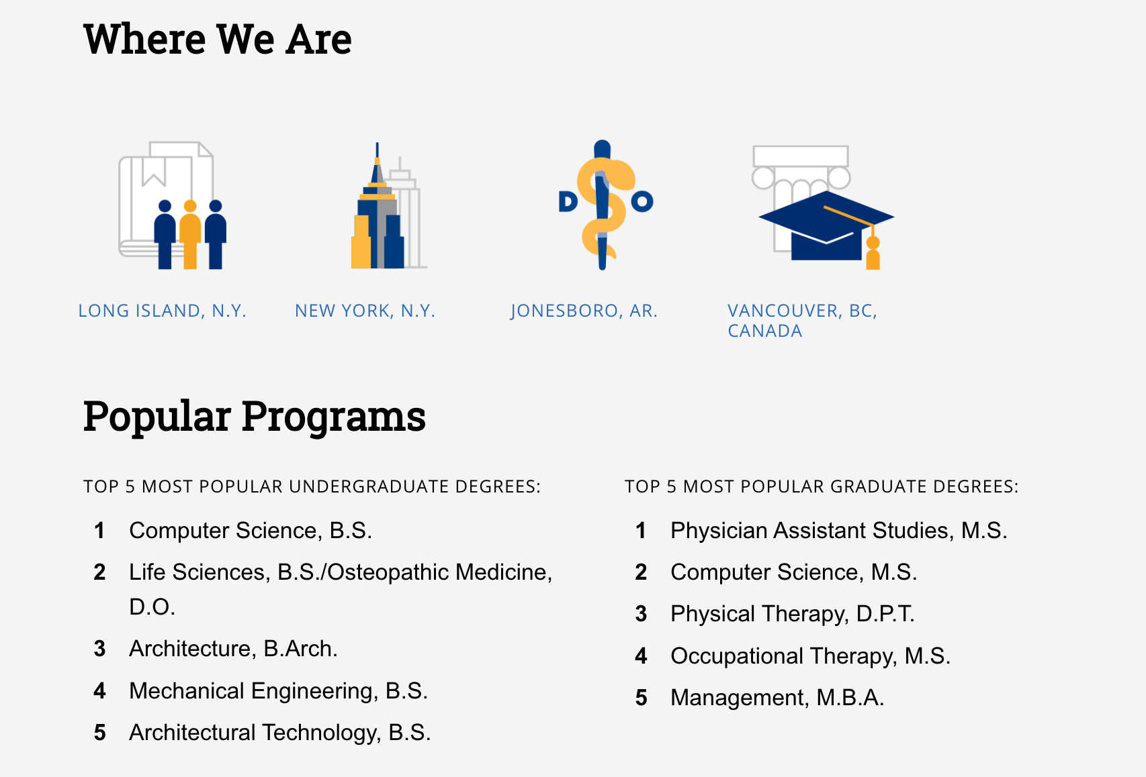

Slide 4
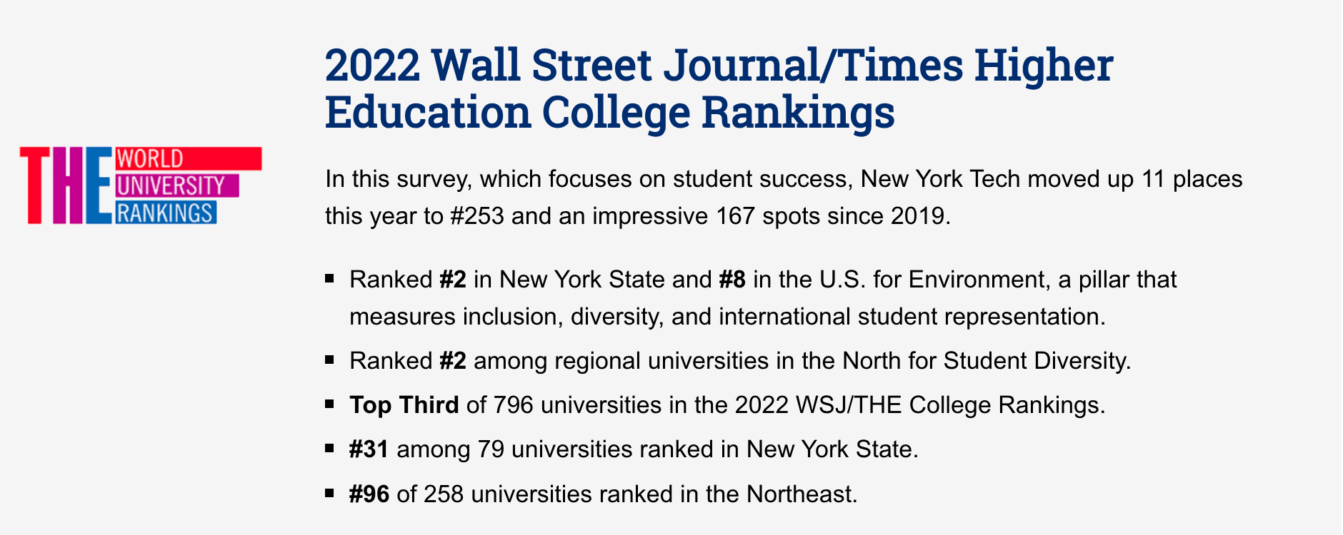

Slide 5
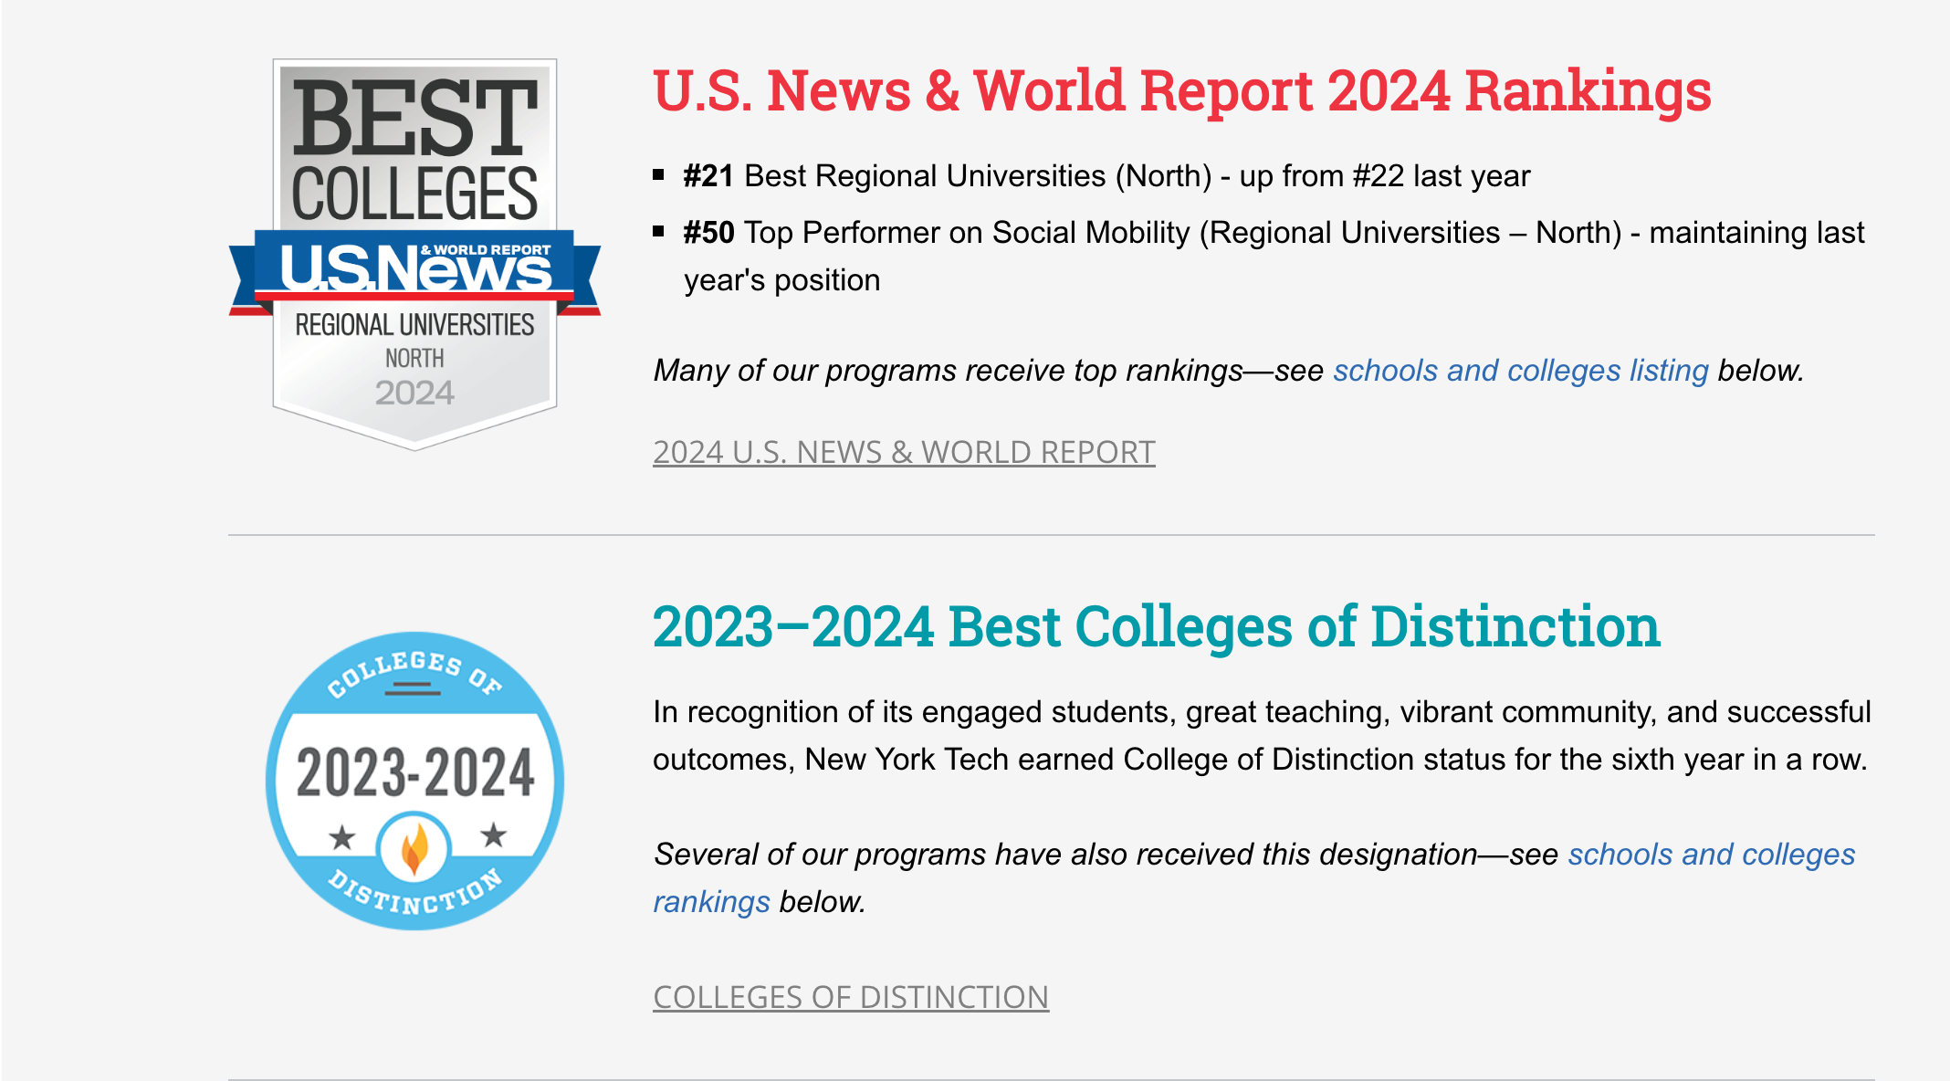

Slide 6
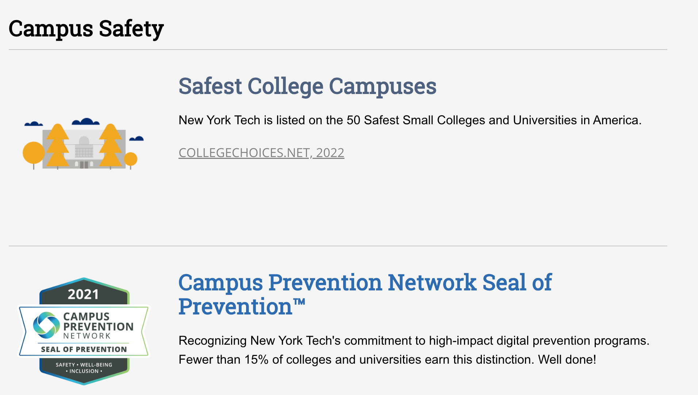

Slide 7
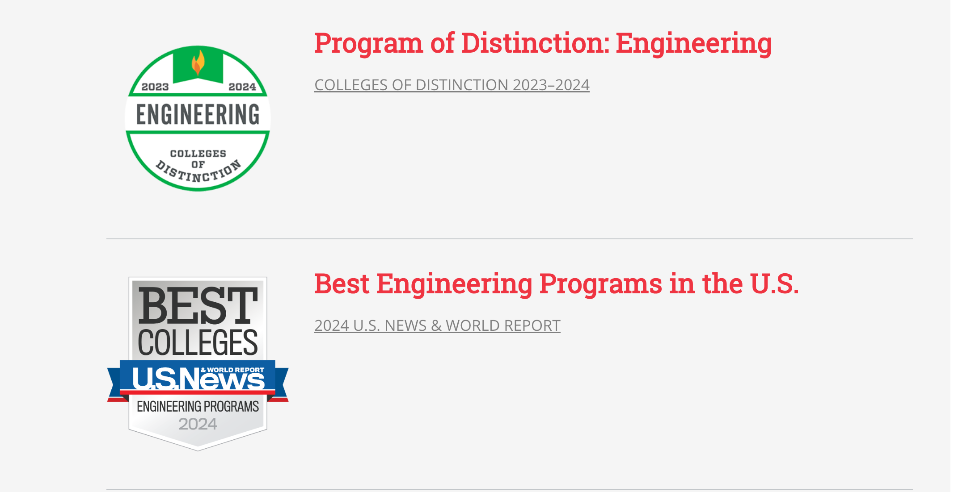

Slide 8

Double degree
LM Ingegneria Meccanica – LM Mechanical Engineering POLIBA
MS Mechanical Engineering NYIT
Sede: Long Island

Slide 9

Double degree
LM Ingegneria Energetica POLIBA
MS Energy Management NYIT
Sede: New York City – Long Island

Slide 10
Programma di studio
21 NYIT crediti (equivalenti a 42 CFU) da conseguire al NYIT, di cui almeno 3 (equivalenti a 6 CFU) di tesi.
Fino ad un massimo di 30 CFU conseguiti al POLIBA vengono riconosciuti da NYIT per ottenere il titolo di laurea del NYIT.
Primo anno presso il POLIBA e secondo anno (o un semestre) presso il NYIT
78 CFU da conseguire al POLIBA, di cui almeno 6 di tesi al rientro a Bari

Slide 11
1. Admission Requirements for PoliBa Students
Enrollment at PoliBa
At least 18 ECTS at the time of application (end of May) and 48 ECTS before the departure to the US (September)
Language certificate: at least B2 level (Common European Framework of Reference for Languages)

Slide 12
2. NYIT Requirement for PoliBa Students
PoliBa students in NYIT's ME/EM Programs will have to complete a minimum 30 US credits in subjects that are pertinent to the NYIT ME/EM degrees.
With consultation with an NYIT advisor, the equivalent of fifteen (15) NYIT credits of the participating students' graduate-level courses taken at PoliBa may be transferred to his/ her degree course of study at NYIT.
The remaining fifteen (15) NYIT degree course credits must be taken at NYIT either face-to-face or by other means (such as online e-learning).
Participating students will be required to prepare a plan of didactic activity (learning agreement), using the ERASMUS+ learning agreement template. It must be coordinated with the program coordinator and approved by the Board of the Department of Mechanics, Mathematics and Management.

Slide 13
3. PoliBa Requirement for PoliBa Students
The participating PoliBa students will have to complete a minimum of seventy eight (78) ECTS at PoliBa and a minimum of twenty one (21) NYIT credits in subjects that are pertinent to the NYIT ME/EM degrees.
Participating PoliBa students need to complete at least seventy two (72) ECTS in subjects that are pertinent to the PoliBa ME/EM degrees and at least six (6) ECTS on thesis work on their return to Italy.
With consultation with a PoliBa advisor, the equivalent of twenty one (21) NYIT credits of the participating students' graduate-level courses taken at PoliBa may be transferred to his/her degree course of study at PoliBa. In particular, ME’s student have to successfully pass the exams MENG 660 “Mechanical Engineering Research” and MENG 661 “Mechanical Engineering Thesis”; instead, EM’s student have to successfully pass the exams ENGY 890 “Practicum or Other Research” and ENGY 830 “Internship Program”.

