Slide 1
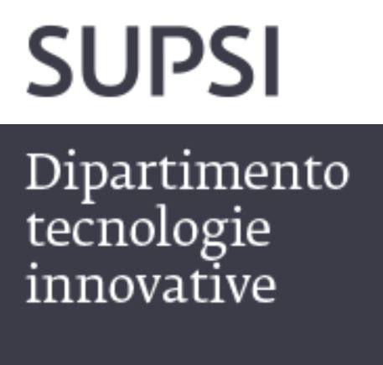

3/2/2026
POLIBA-SUPSI DOUBLE DEGREE MASTER OF SCIENCE IN MECHANICAL ENGINEERING
Prof. Giuseppe Casalino
Notes:
Fondata nel 1997, una delle 9 università professionali svizzere
Missione: formazione, ricerca applicata e servizi al territorio
Offre bachelor, master e formazione continua (CAS/DAS/MAS/EMBA)

Slide 2
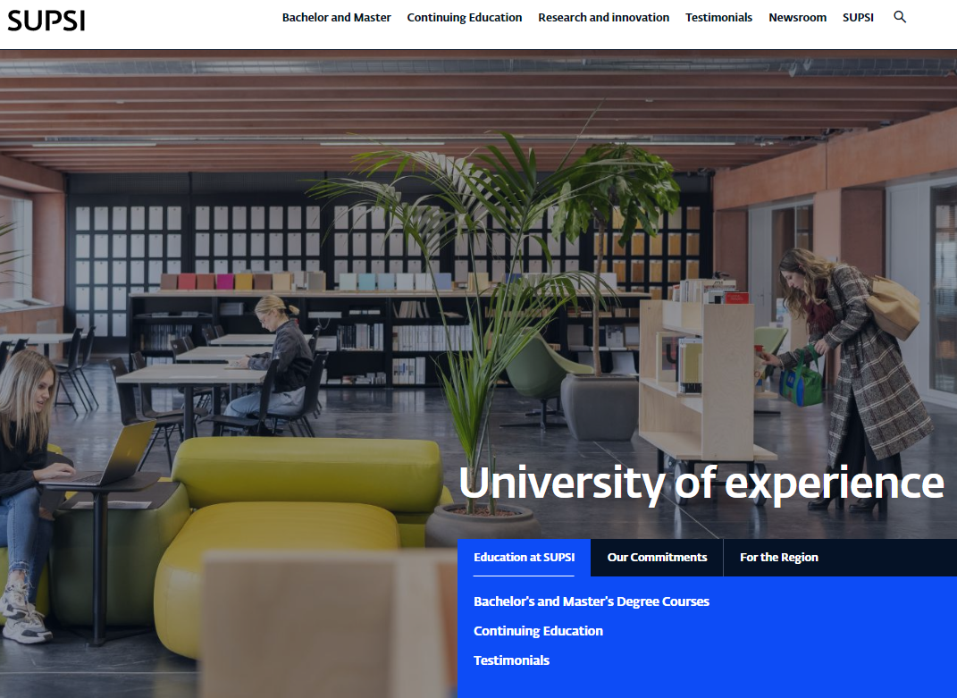
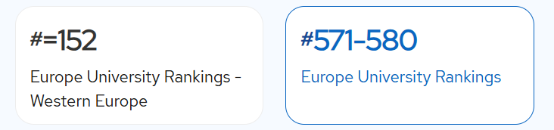
www.supsi.ch
The University of Applied Sciences and Arts of Southern Switzerland (SUPSI) is one of the nine technical universities recognised by the Swiss Confederation.
Notes:
Fondata nel 1997, una delle 9 università professionali svizzere
Missione: formazione, ricerca applicata e servizi al territorio
Offre bachelor, master e formazione continua (CAS/DAS/MAS/EMBA)

Slide 3
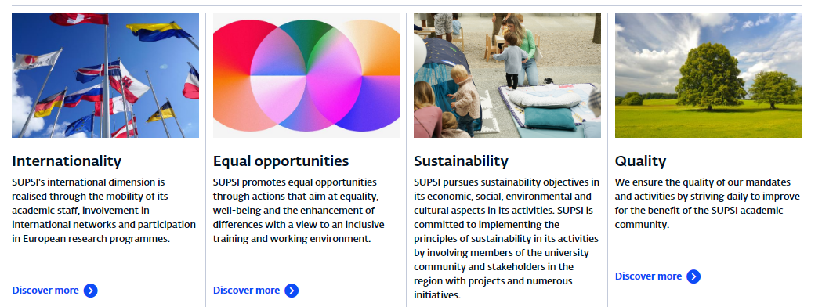
SUPSI COMMITMENTS

Slide 4
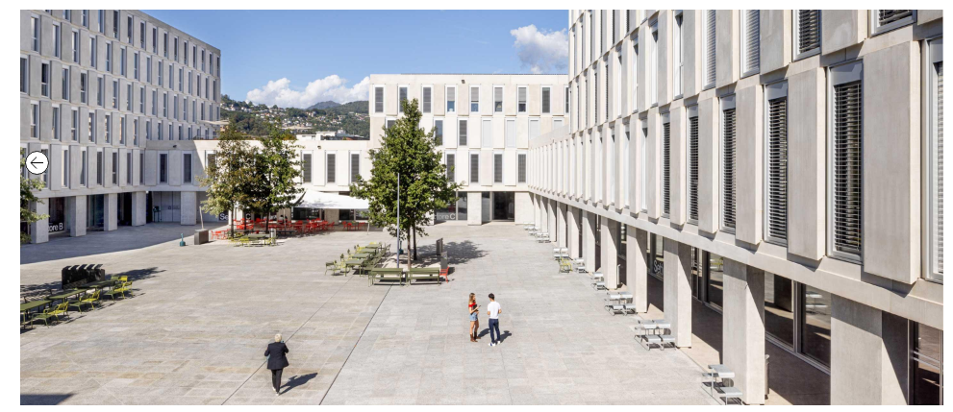
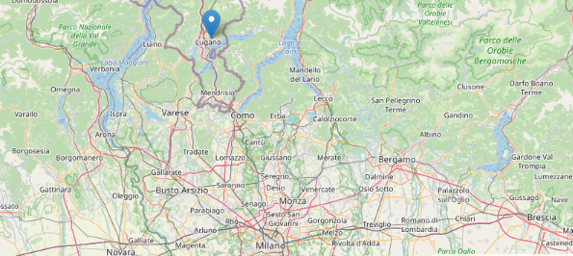
The Department of Innovative Technologies
Lugano-Viganello, East Campus
https://www.supsi.ch/en/lugano-east-campus-usi-supsi%C2%A0
Notes:
https://www.supsi.ch/en/lugano-east-campus-usi-supsi%C2%A0

Slide 5
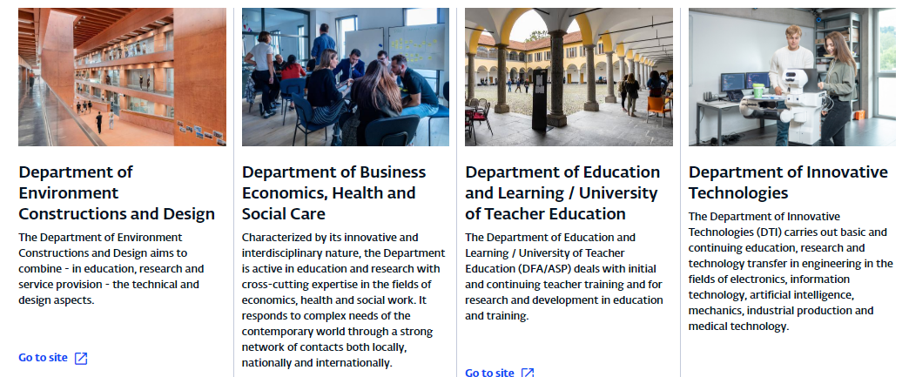
Viganello’s Departments

Slide 6
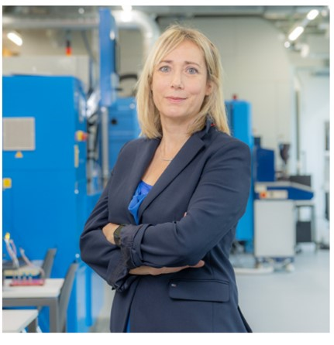
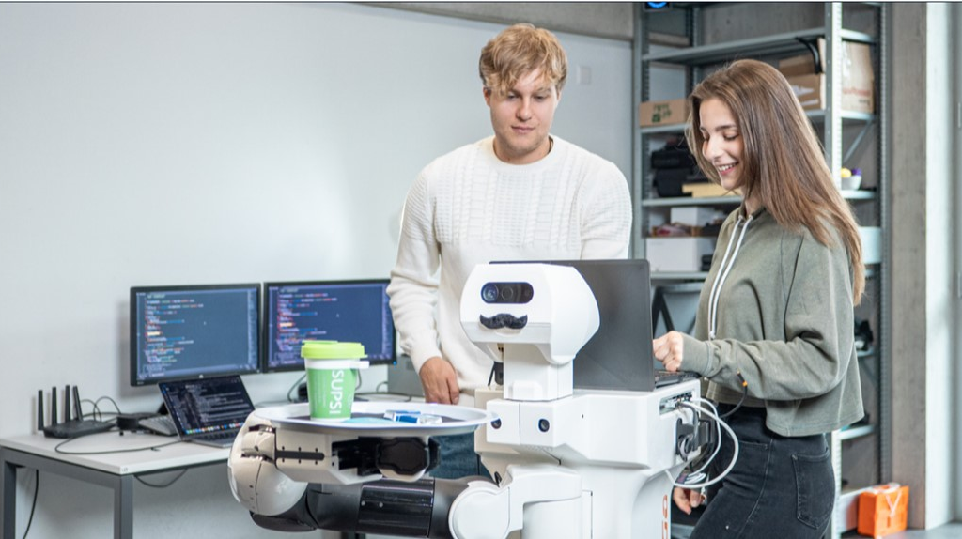
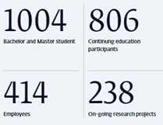
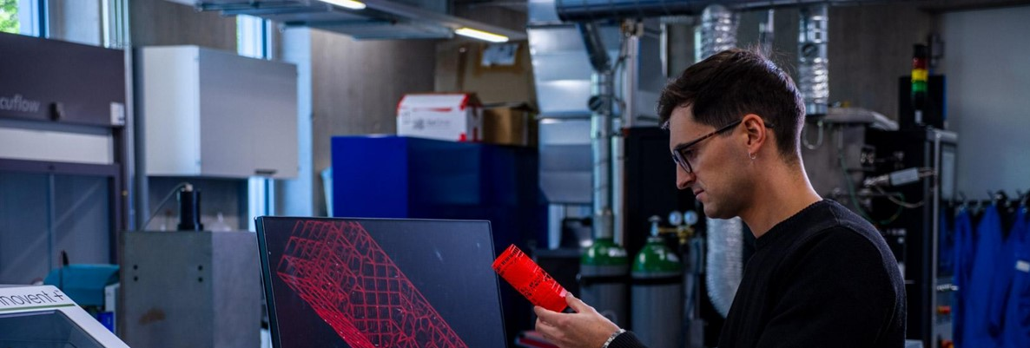
Prof. Dr. Milena Properzi
Director of the Department of Innovative Technologies
Master of Science in Engineering - Mechanical Engineering
The Master of Science in Engineering profile in Mechanical Engineering trains professionals in the development, production, use and optimization of machines, materials, plants and products in industrial, scientific and regulatory fields.
https://www.supsi.ch/en/mse-mechanical-engineering
Notes:
https://www.supsi.ch/en/mse-mechanical-engineering

Slide 7
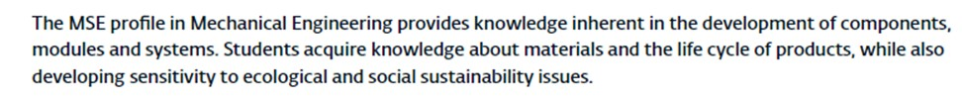
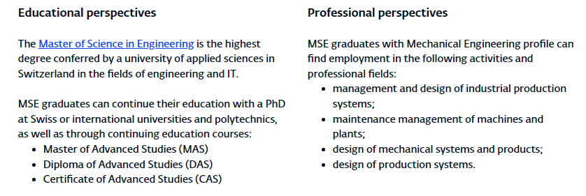
Master of Science in Engineering - Mechanical Engineering: Competences
Educational and professional perspectives

Slide 8
Double Degree with SUPSI: Key Points of Interest for Applying
Students earn two officially recognized Master’s degrees: Master’s Degree in Mechanical Engineering (from the Italian home university) and Master of Science in Engineering (Mechanical Engineering and/or Mechatronics & Automation) from SUPSI, Switzerland.
International and Multicultural Experience. The program includes a mandatory one-year mobility period in Lugano, offering exposure to a multicultural academic and professional environment in Switzerland.
Strong Focus on Engineering Innovation. The curriculum emphasizes mechanical engineering, mechatronics, automation, robotics, advanced manufacturing, and sustainability, preparing students for cutting-edge industrial applications.
Career Advantages in the European Job Market. Graduates gain strong competitiveness, improved employability, and access to international career opportunities, especially in industrial, manufacturing, automation, and R&D sectors.

Slide 9
Structured and Guaranteed Credit Recognition. All exams passed at the host university are fully recognized by the home university through the ECTS system, with no loss of academic time.
Single Tuition Fee. Students pay tuition only at their home university, reducing financial burden while studying abroad (only minor diploma fees may apply).
English-Taught Thesis and Academic Integration. The Master’s thesis is written in English and co-supervised by professors from both universities, strengthening academic quality and international research skills.
Limited and Selective Program. The program admits a small number of students each year, ensuring personalized academic support and high-quality teaching.
Professional and Applied Education at SUPSI. SUPSI is a University of Applied Sciences, offering a strong link between theory and practice, industry-oriented courses, laboratories, and applied research projects.
Support Services for International Students. Students receive assistance with visas, residence permits, and integration activities, making the transition to Switzerland smoother.

Slide 10
During the year that Poliba students spend in Lugano, they are required to obtain 60 ECTS credits in total.
These credits are divided as follows:
21 ECTS from specialized courses, focused on advanced topics in mechanical engineering, mechatronics, automation, and related fields, taught at SUPSI.
39 ECTS from the Master’s thesis and seminars, which are carried out in close collaboration with Swiss companies and research laboratories.
Notes:
This structure allows students to combine advanced academic training with hands-on industrial and research experience in Switzerland, strengthening both their technical skills and their professional profile in an international context.

Slide 11
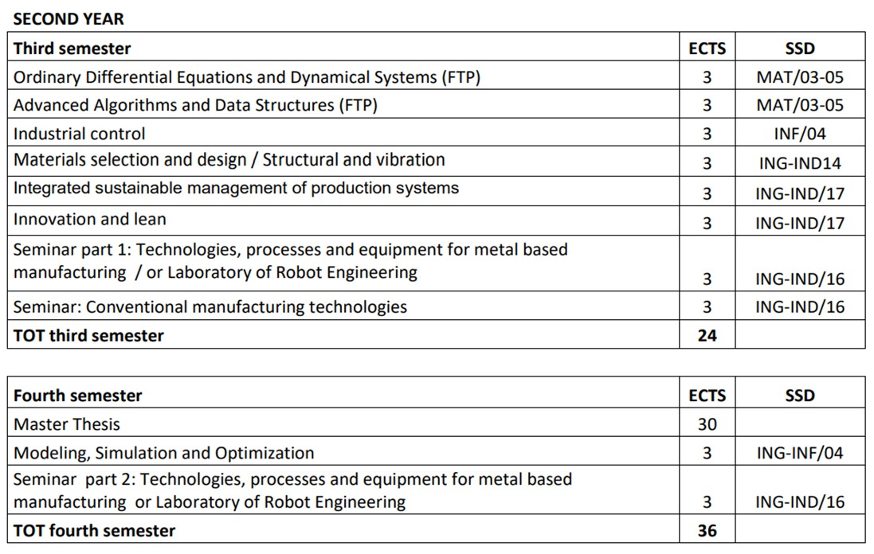

Slide 12
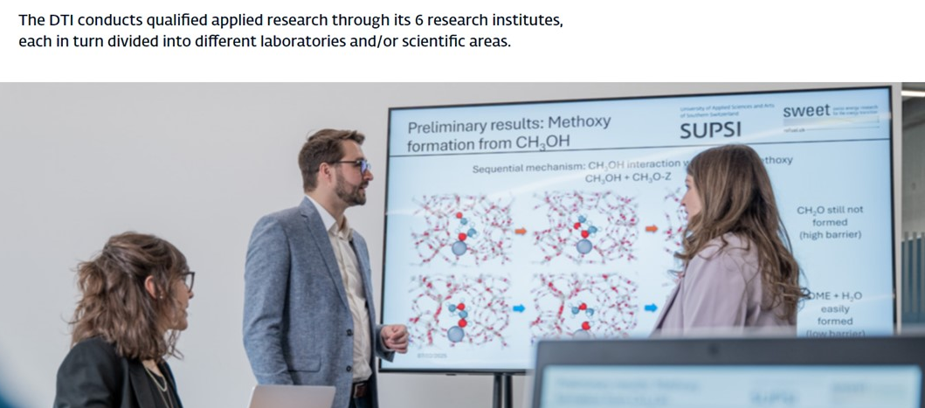
SUPSI research Institutes related to the Mechanical Engineering
Notes:
The DTI conducts high-quality applied research through its six research institutes, each organized into specialized laboratories and scientific areas where students are actively involved. Students have the opportunity to participate directly in research projects, work alongside professors and researchers, and apply theoretical knowledge to practical challenges, often in collaboration with industrial partners. This close involvement enhances technical skills, research capabilities, and professional readiness.

Slide 13
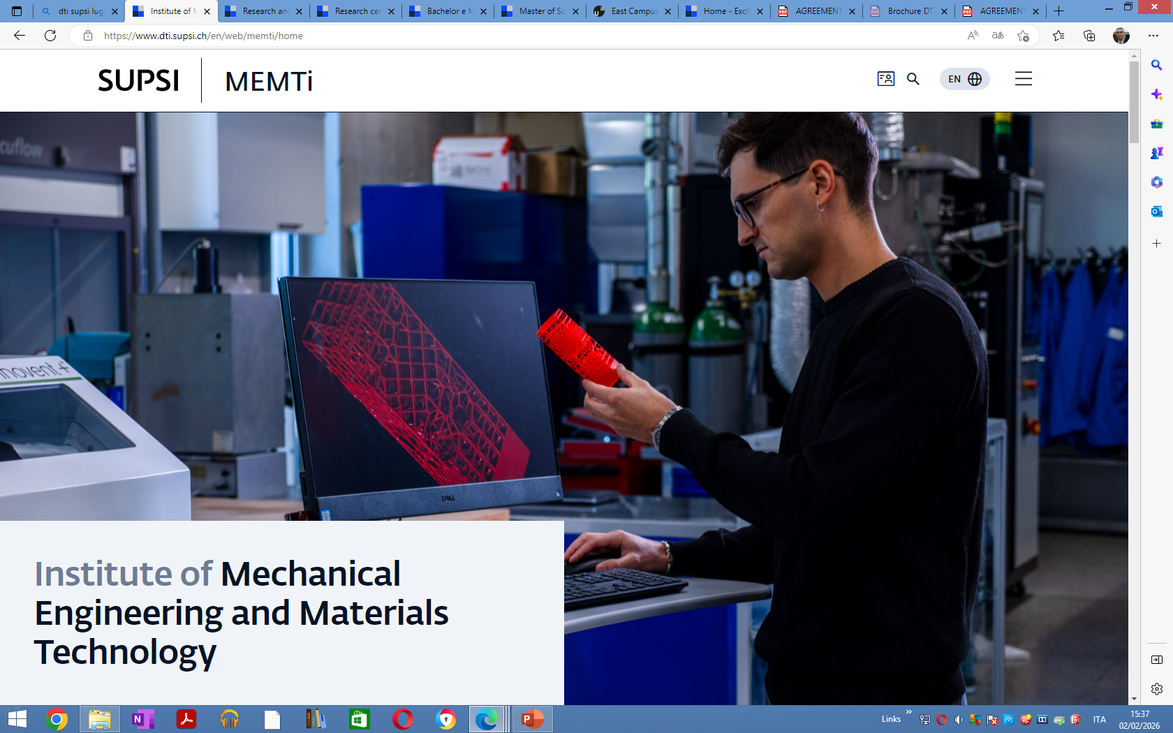
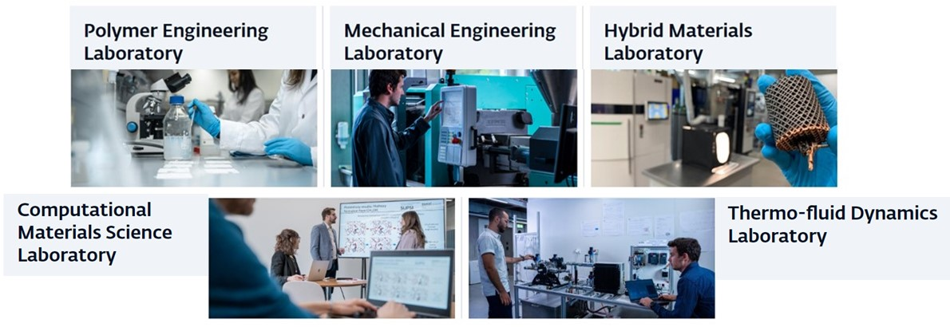
https://www.dti.supsi.ch/en/web/memti/home
Notes:
MEMTi integrates materials science and mechanical engineering to develop applied research on advanced materials, mechanical components and systems, energy, and processes, collaborating with companies and institutions to foster innovation and technology transfer.
https://www.dti.supsi.ch/en/web/memti/home

Slide 14
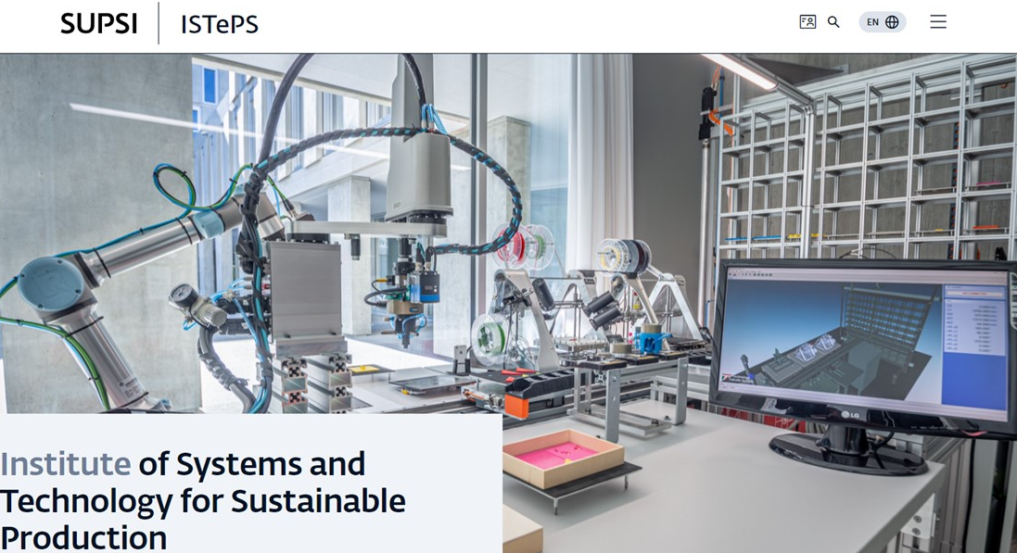
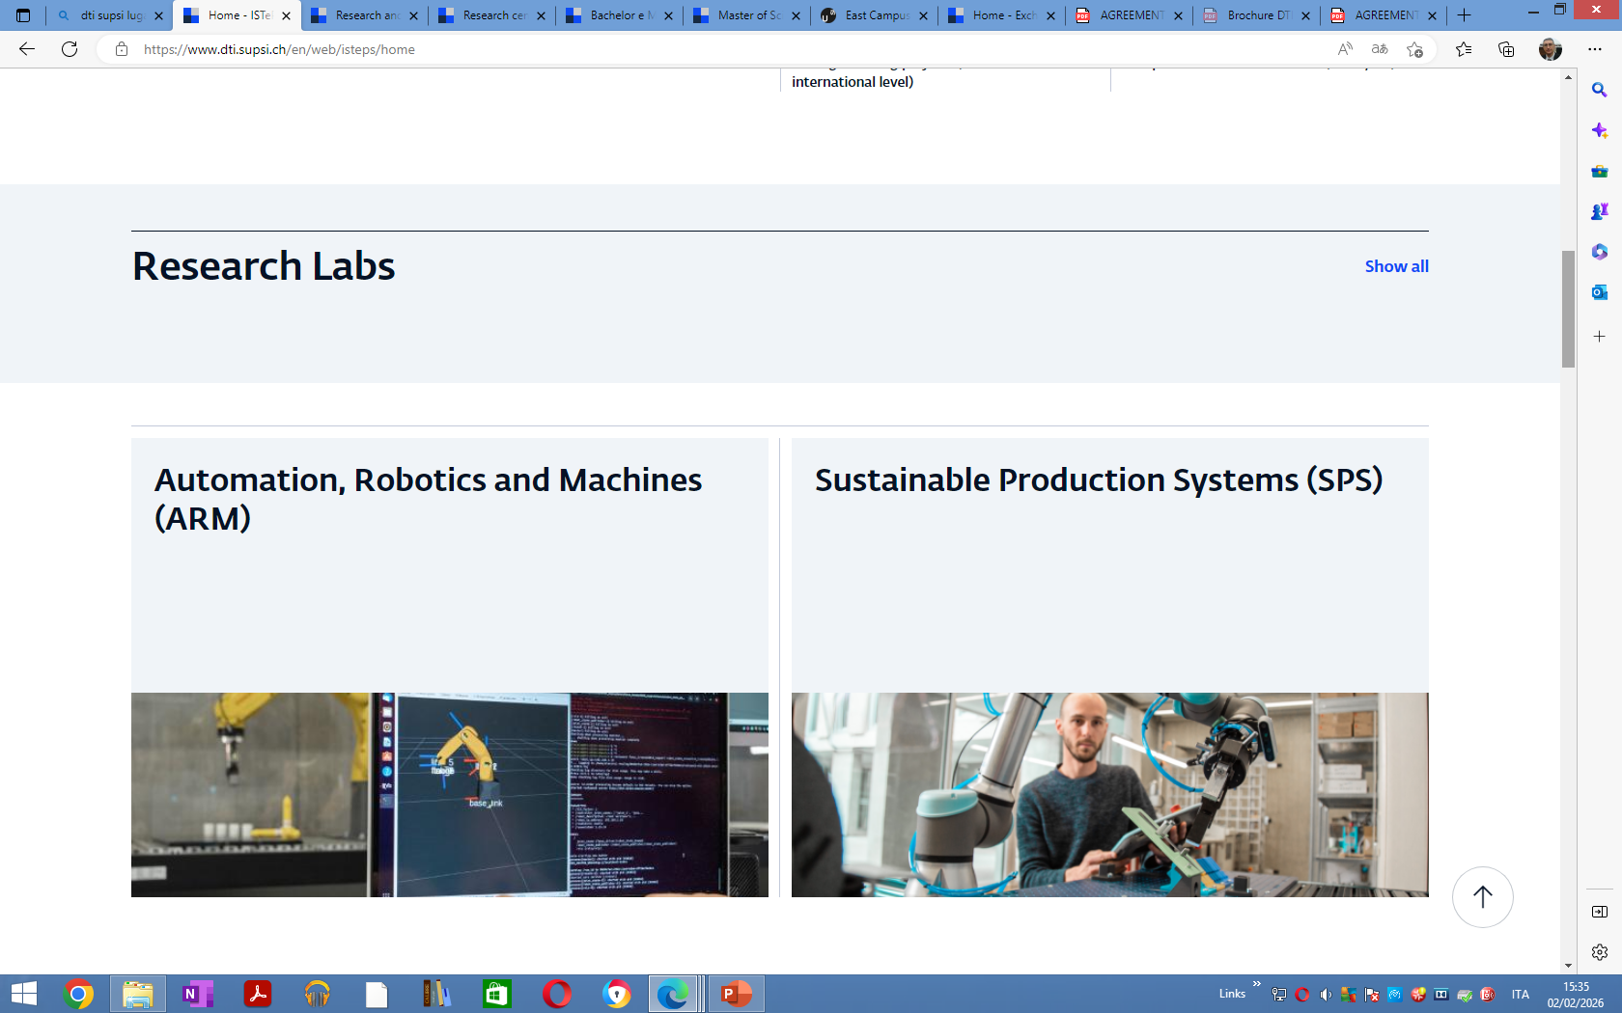
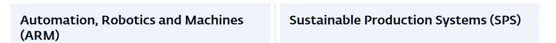
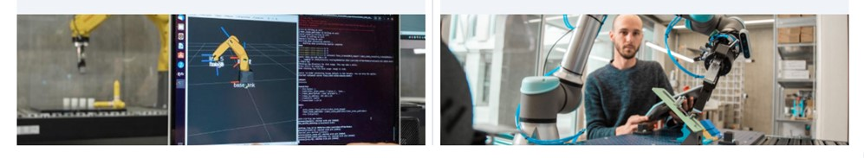
https://www.dti.supsi.ch/en/web/isteps/home
Notes:
The Institute, active within the Department of Innovative Technologies, conducts applied research at national and international level in the field of design and management of production systems with a focus on innovation in manufacturing systems, production processes, products and business models.
https://www.dti.supsi.ch/en/web/isteps/home

Slide 15
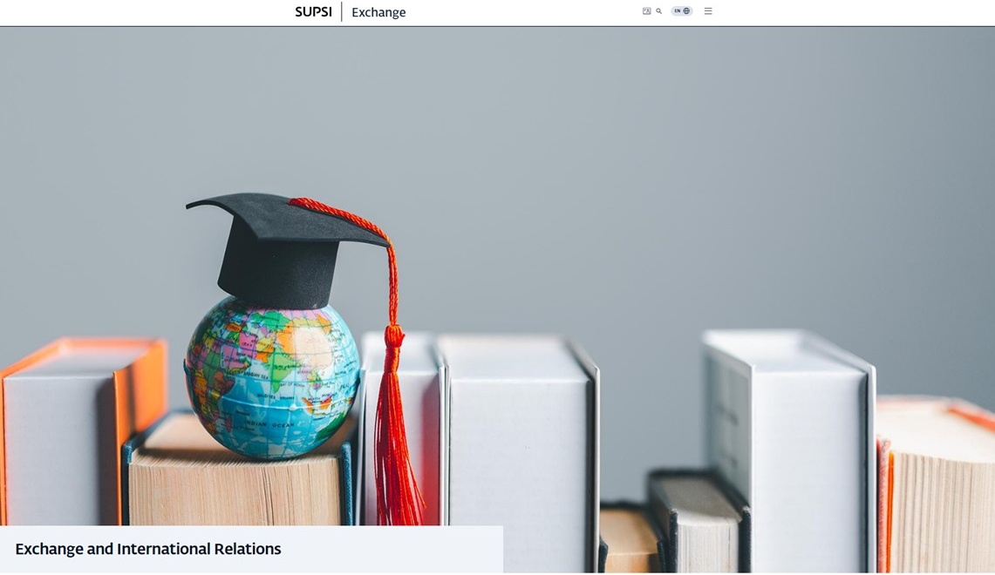
https://exchange.supsi.ch/en/home
Incoming students
SUPSI encourages mobility between institutions and welcomes Swiss, European and international students for study, internship and thesis activities, subject to agreement with the university of origin.
Notes:
https://exchange.supsi.ch/en/home
The goal of Exchange and International Relations is to promote and manage international mobility and cooperation by supporting students, faculty, and institutions in cross-border academic activities.
More specifically, its main objectives are to:
Facilitate student and staff mobility through exchange programs, double degrees, and international study opportunities.
Develop and strengthen partnerships with foreign universities, research institutions, and international organizations.
Support international students and outgoing students by providing guidance on applications, visas, residence permits, and integration.
Enhance the international dimension of education and research, fostering intercultural competence and global perspectives.
Promote the institution’s international visibility and attractiveness in the global academic environment.

Slide 16
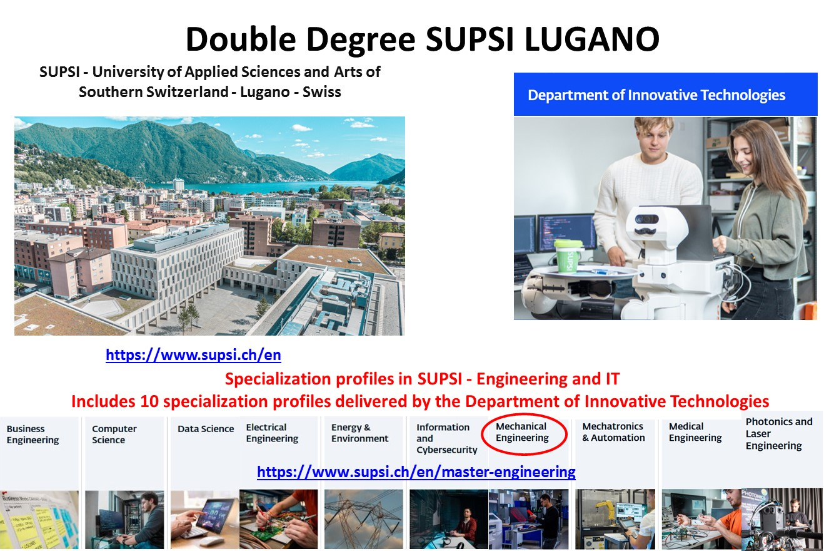
THANK YOU
Notes:
Fondata nel 1997, una delle 9 università professionali svizzere
Missione: formazione, ricerca applicata e servizi al territorio
Offre bachelor, master e formazione continua (CAS/DAS/MAS/EMBA)

